Slide 1
Algorithmic Trading Tutor
James Michael Matthew Gallagher

Slide 2
Aim : Create an online teaching tool to educate users about financial trading algorithms

Slide 3
Motivations : Rise of prominence of the industry
As of 2011, Automated trading accounted for over 73% of all US equity trading volume.
In 2006, at the London Stock Exchange, over 40% of all orders were entered by algorithmic traders.

Slide 4
Motivations : High Profile News Stories Increasing Interest in the Field.
Knight Capital ex-largest automated trading firm of U.S. equities. In its prime had a market share of over 17% of the NYSE
On August 1, 2012, Knight Capital accidentally deployed test software code to a production environment.
Lost $440 million in 30 minutes.
The next day 75 % of Knight's equity value had been erased.

Slide 5
Motivations : Increased Awareness of Potential Dangers
Algorithmic trading has been found to decrease market price stability.
2010 May 6th Flash Crash saw the Dow Jones Industrial Average plunged 600 points in 5 minutes, wiping $600 billion off the market value ( 9%).
Dow : IBM, Microsoft, Intel, JP Morgan, Nike, Coca-Cola. .
The drop was broadcast live on CNBC, with commentator Jim Cramer declaring live, "That is not a real price ! ! Just go buy ! !”
Regulators found HFT's exacerbated price declines.

Slide 6
Aim : Create in interactive tool to teach user about two selected financial trading algorithms.
Teach users how to operation two trading algorithms.
Teach users the challenges that these algorithms are designed to tackle.
Teach users about the code implementation of these algorithms .
Teach users technically terminology related to the field.
Let users create and add their own algorithms to the teaching tool.

Slide 7
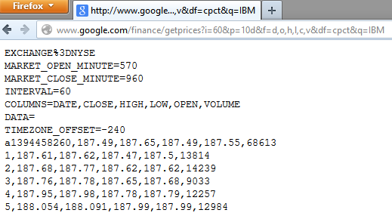
Historic Tick Data : Google Finance
http://www.google.com/finance/getprices?i=[PERIOD]&p=[DAYS]d&f=d,o,h,l,c,v&df=cpct&q=[TICKER].
First a high quality data source of historic stock had to be found
The service works by sending a URL request query to the service contain stock, date and frequency information of the stock required. The service then print out the requested information in a .csv file

Slide 8
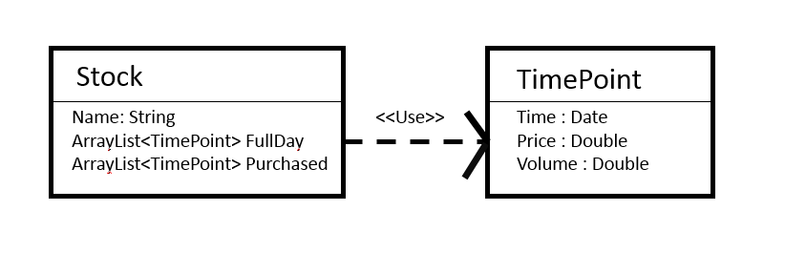
Data Structures

Slide 9
Time Weighted Average Price Algorithm
A natural extension of early Order Slicing based trading strategies.
Belongs to the family of Impact Driven Trading Algorithms.
Schedule based algorithm. Does not respond to changes in the stocks its purchasings price or volume .
The benchmark that T.W.A.P algorithm follows is a time schedule.
Input Parameters : Start Time/ End Time / Amount /Period

Slide 10
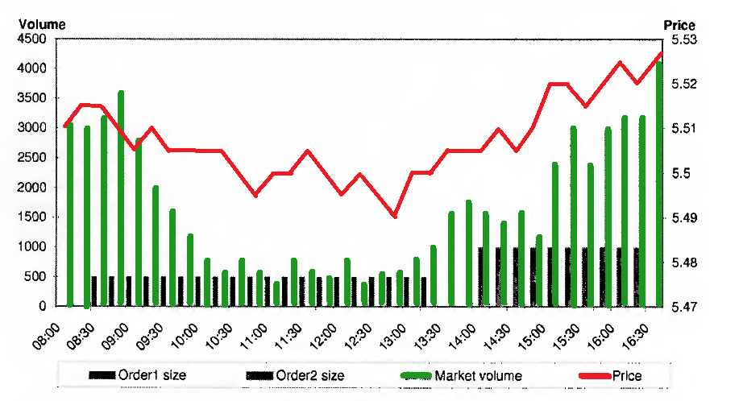
Time Weighted Average Price Algorithm

Slide 11
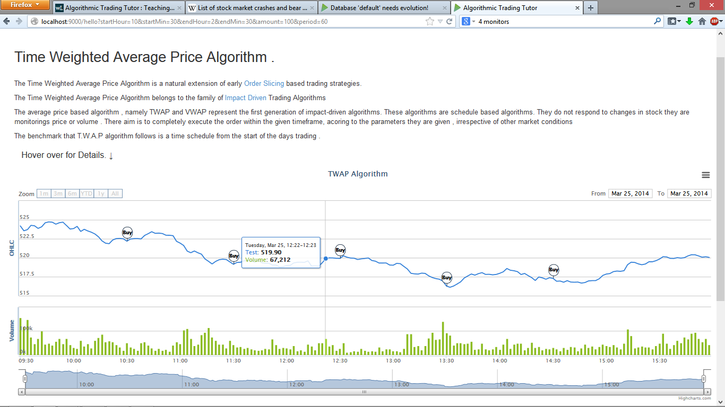

Slide 12
Percentage of Volume Algorithm
A natural extension of a market “follow” based trading strategy.
Belongs to the family of Impact Driven Trading Algorithms.
POV algorithms the trading schedule is dynamically determined. .
The benchmark that T.W.A.P algorithm follows is a market volume.
Input Parameters : Start Time/ Amount / % benchmark

Slide 13
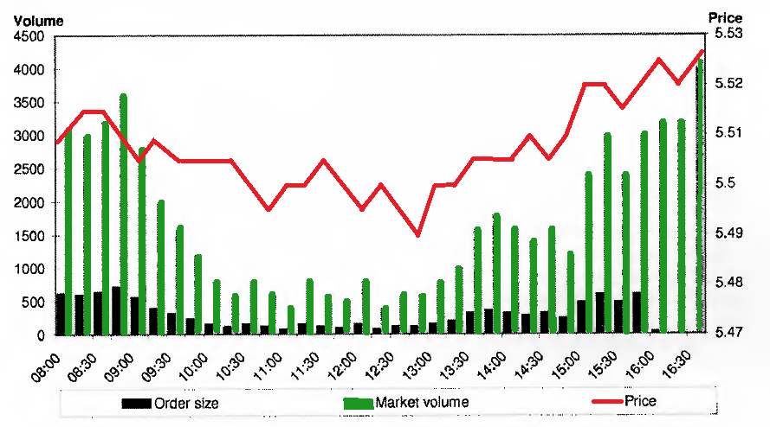
Percentage of Volume Algorithm

Slide 14
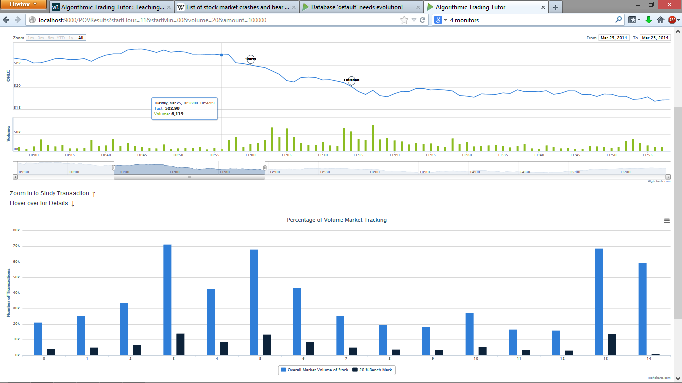

Slide 15
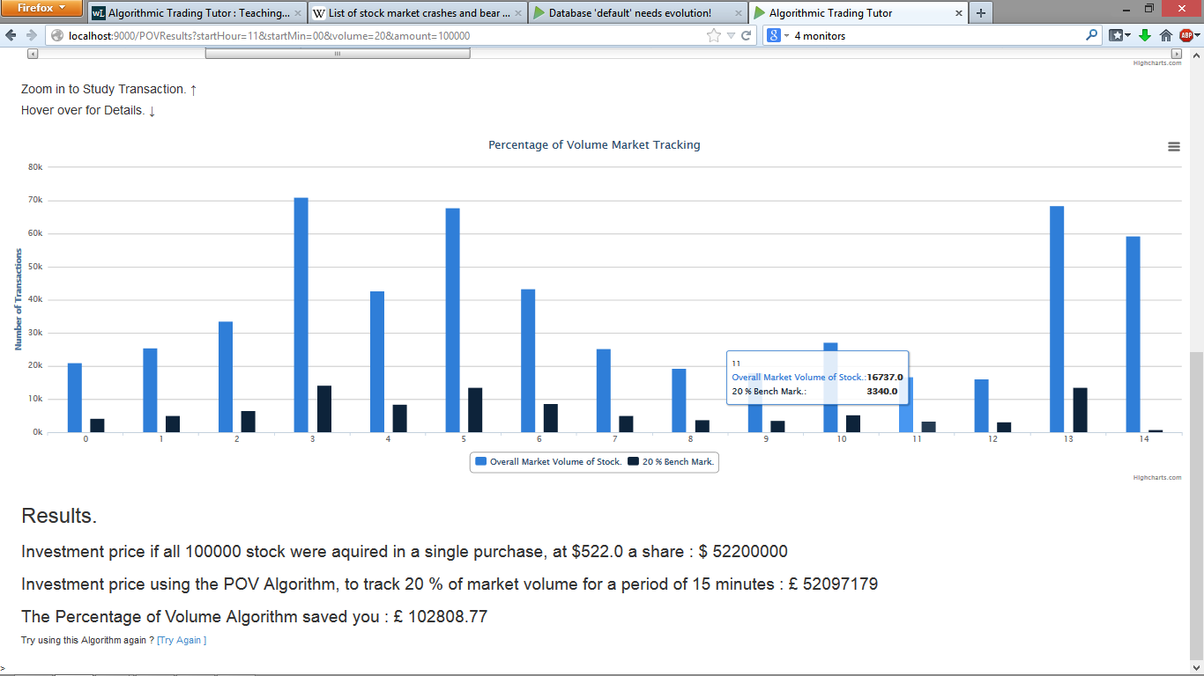

Slide 16
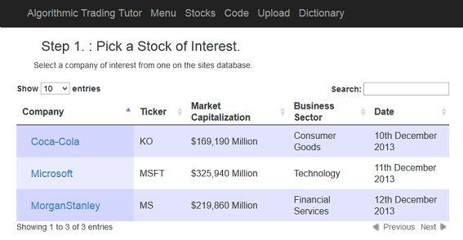
Provide Historic stock data for the algorithms to operate on . .
An in-memory, embedded deployment of the h2 database was used combined with the Ebean ORM.
Javascript library DataTables was used to create a user interface. Offers several pieces of additional interactive functionality to plain HTML tables . This functionality includes : Variable table length pagination/On-the-fly filtering, Multi-column sorting and auto handling column widths

Slide 17
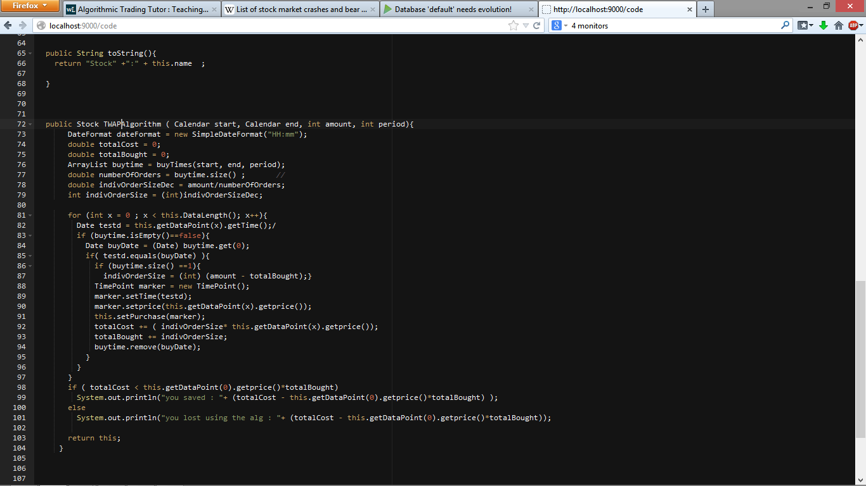
Aim : Teach users about the code implementation of these algorithms
JavaScript browser based editor Ace.js was used to show user the code implementation of the sites algorithms.

Slide 18
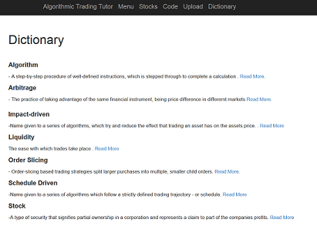
Aim : Teach users technically terminology of the field.

Slide 19
Web Based Learning :HyperLinks
ALFORD (2002 ) :
Hyperlink and searching capabilities, fit well into the constructivist learning theory, where learners search out and create their own knowledge bases .

Slide 20
Aim : Let users create and add their own algorithms to the system.

Slide 21
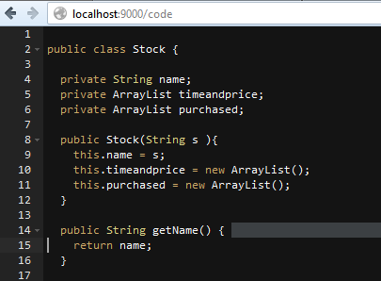
Aim : Let users create and add their own algorithms to the system.
JAR File

Slide 22
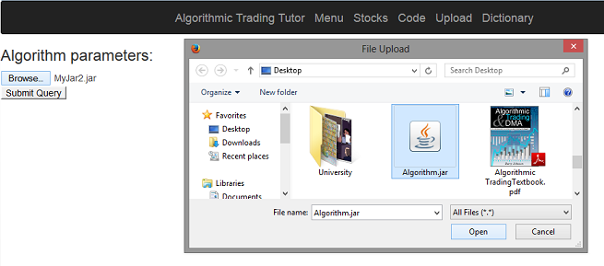
Aim : Let users create and add their own algorithms to the teaching tool

Slide 23
Aim : Let users create and add their own algorithms to the teaching tool
A java ClassLoader object is used to load the classes contained in the uploaded JAR file onto the running web applications Classpath.
An instance of the newly loaded timepoint class is instantiated. This is used with a default date object set to the time of market open , and a default stock data input file to instantiate a copy of the newly loaded stock class.
Once the newly loaded in stock class has been created, the user defined algorithm contained inside the Stock class is then executed.
The loaded in stock class cannot be used to interact with any of the running systems defined functions due to possible security conflicts . A stock object which is instantiated from the running web application is instantiated , and the values from the two timepoint arrays of the JAR originated stock class are copied into this newly instantiated identical class.
The purchased array of the newly instantiated stock class, which originates from the running web application, is then used as output information to be input into a Scala play template and displayed on the system via highstocks.js

Slide 24
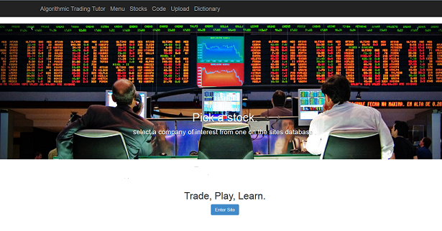
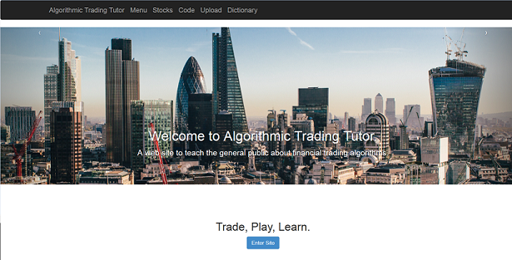
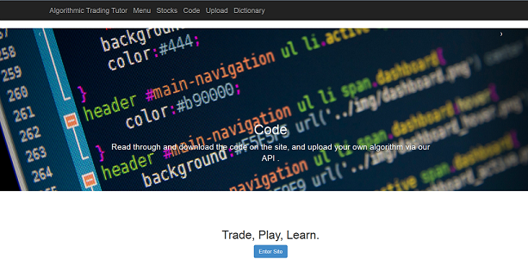
User Interface . .

Slide 25
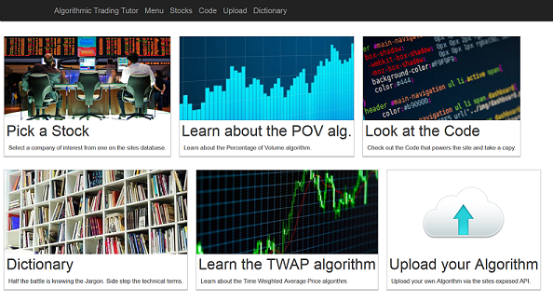
Menu Screen . .

Slide 26
Evaluation : Participant Brief -> Think Aloud -> Questionnaire (x2)
Participant Brief : Described the aims and motivations behind the system . Asked to answer a few simple questions to gauge their competency using web based applications, and to gauge their personal interest and background experience in the systems domain.
Think Aloud : Participants were encouraged to talk out loud as they performed a series of tasks, designed to provide a full overview of the complete functionality provided by the system.
Questionnaire : Users were asked them to rate their interest in the applications after their initial experience using the system.
2 x 4 Test Subjects .

Slide 27
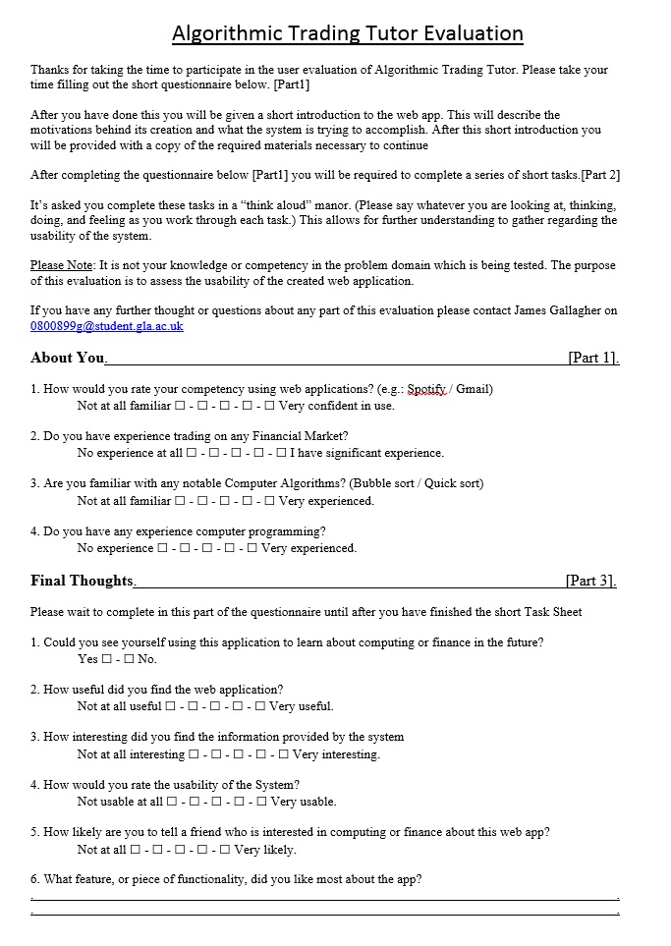
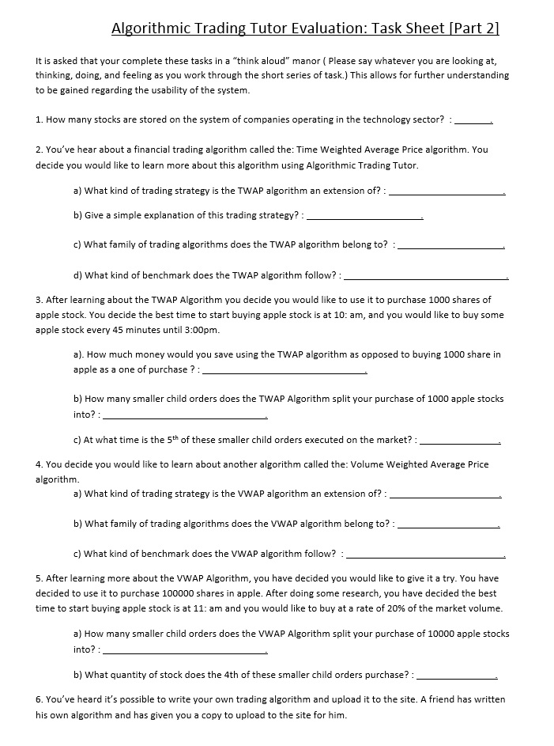

Slide 28
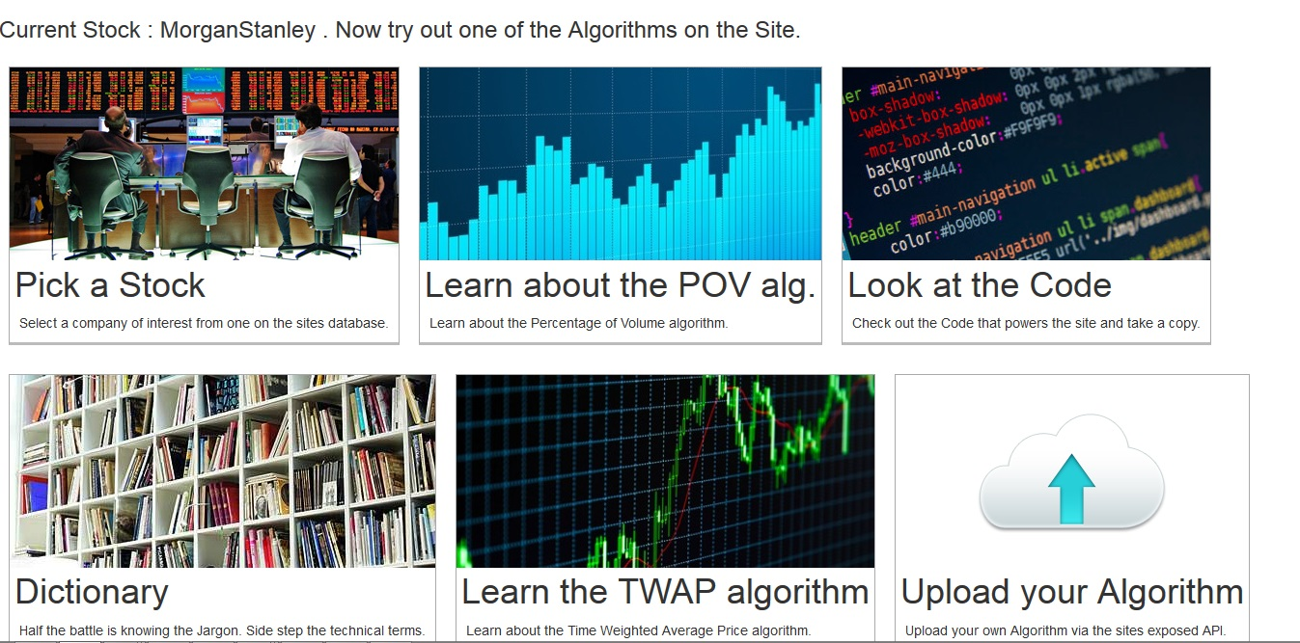
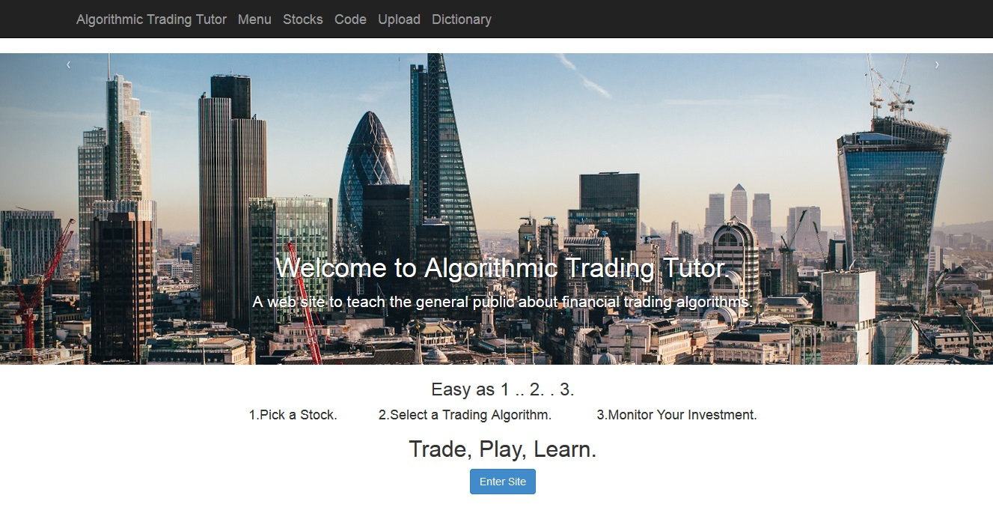
Usability Evaluation Results : Highlight The System Workflow

Slide 29
Usability Evaluation Results : Highlight System functionality

Slide 30
Usability Evaluation Results : Highlight Algorithms Results

Slide 31
Evaluation Results : Bugs
An unused action button had been left in on the third slide
The menu bar at the top of the screen had not been added to the sites "select stock" page
The sizing of the background image of the third slide in the sites welcome page slide show was being displayed at an incorrect ratio.
+ Typo’s / Ambiguous language / Alternative terminology /etc. .

Slide 32
Conclusion
Created in interactive tool to teach user about two selected trading algorithms.
Users learn about the operation of the two algorithms by selecting historical stock data for the algorithms to operate on, and entering input parameters to the algorithms.
Users can learn about the operation of the two algorithms by viewing the code implementation of each of the algorithms.
Us can inquire about any unknown technically terminology used to explain their operation by using the site dictionary.
Advanced users can take a copy of one of the sites hosted algorithms, modify it, and then up upload it to be viewed on the system.

Slide 33
Thanks
Huge Thanks to Tim Storer for his extensive guidance, knowledge, and support throughout the project .

